Slide 1
Creating and removing directories
mkdir to make directories
Relative mode: mkdir CSCI330
Absolute mode: mkdir /home/CSCI330
If you need to create intermediate directories, use the –p option as in
mkdir –p /home/CSCI330/folder1/subfolder
4
Operations for directories and files

Slide 2
Creating and removing directories
rmdir to remove empty directories
Relative mode: rmdir CSCI330
Absolute mode: rmdir /home/CSCI330
5
Operations for directories and files

Slide 3
Removing files or directories
rm to remove anything
-r Recursive remove. Removes a folder and all that’s in it, empty or not. Careful!!
-f Force. Doesn’t ask for confirmation.
-i Asks confirmation before every removal.
-I Asks confirmation before many removals.
10
Operations for directories and files

Slide 4
Removing files or directories
Wildcard characters
They allow for pattern matching. You want to do something on all files/directories whose name follows a specific pattern.
Character | Description | Example
* | Match any number of characters (so zero or more…) | rm *.c
? | Match a single character | rm conf.?
[lower-upper] | Match any character in range | rm lib-id[3-7].o
[list] | Match any single character in list | rm conf.[co]
str{str1,str2,…} | Match any multiple characters in { } | rm c*.{700,300}
11
Operations for directories and files

Slide 5
Copying files or directories
cp source source source target
You can copy multiple files at the same time.
Either list them all, or use pattern matching.
-i Asks for confirmation if the target already exists
-p Preserves permissions and modification times
-r Recursively copies a folder and its subfolders
18
Operations for directories and files

Slide 6
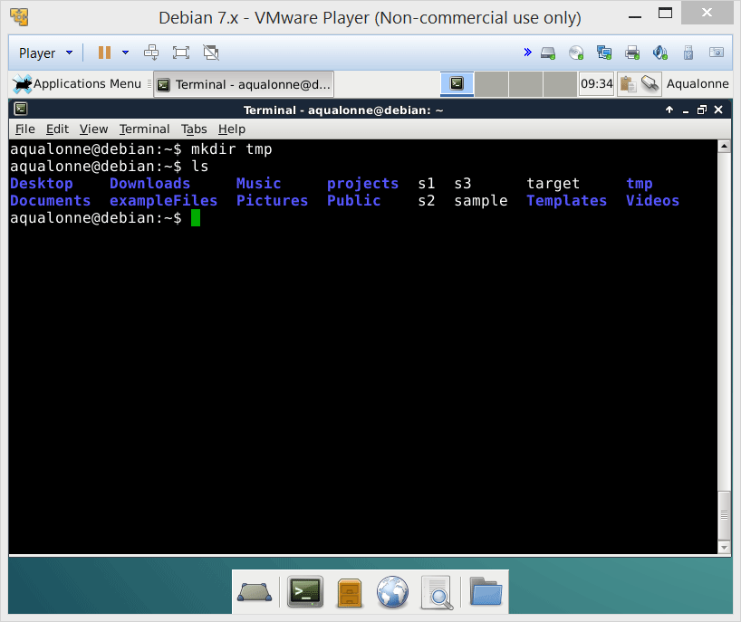
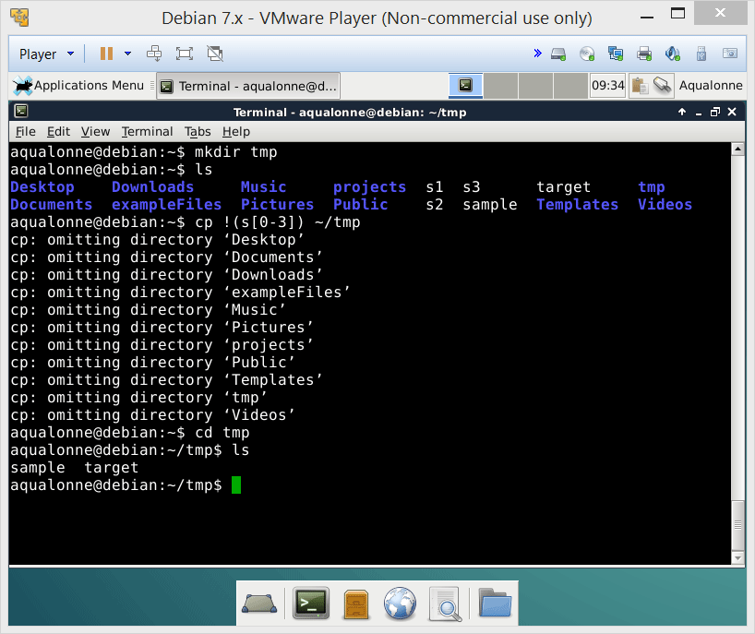
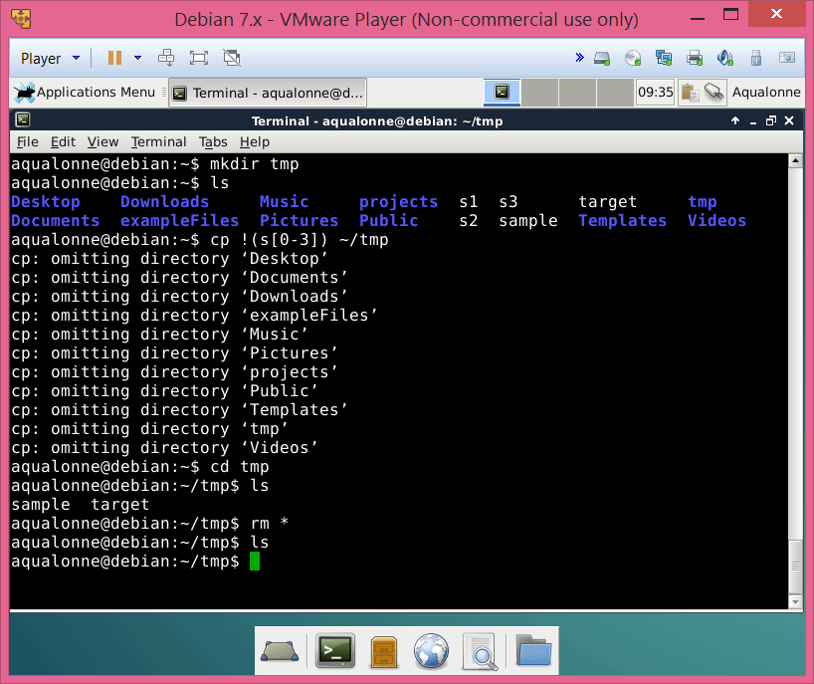
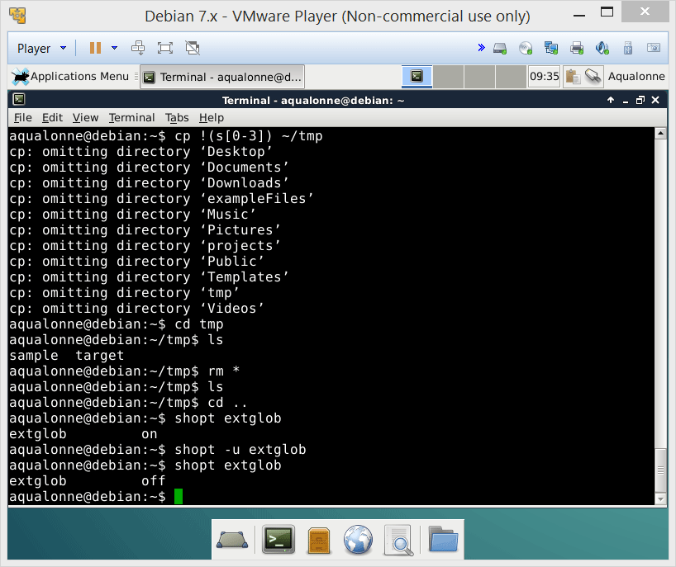
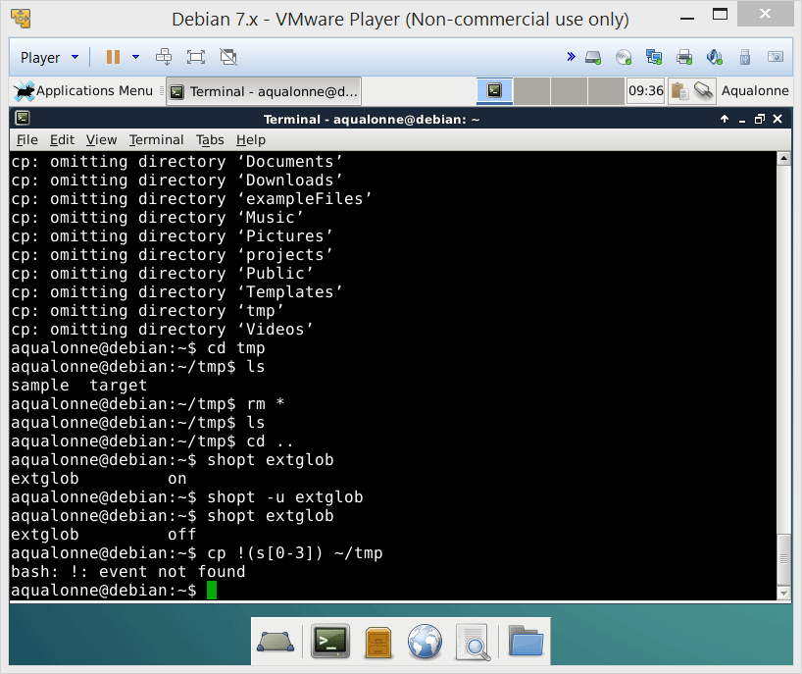
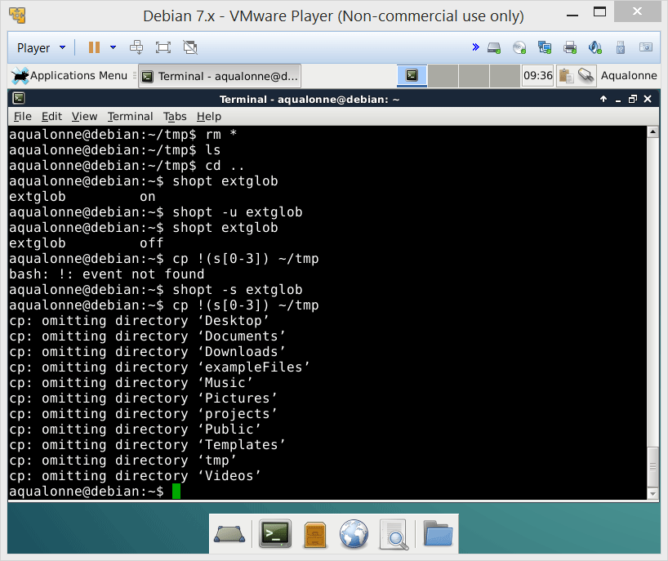
Copying files or directories
19
Operations for directories and files

Slide 7
Copying files or directories
If you want more powerful pattern matching options (such as specifying what you don’t wish to copy), use
shopt -s extglob
Some of the additional options you get will include:
! Match anything but...
@ Match exactly one
+ Match one or more
20
Operations for directories and files

Slide 8

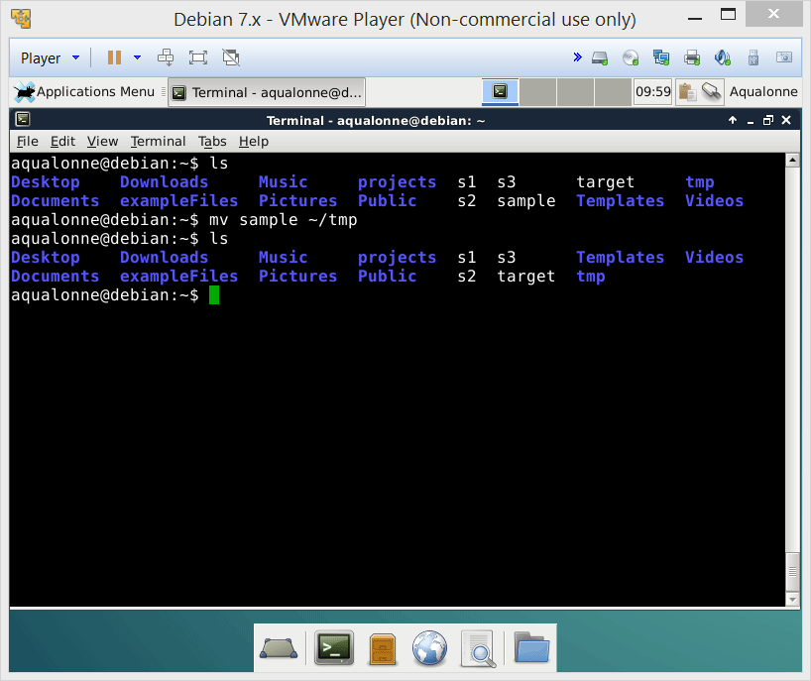
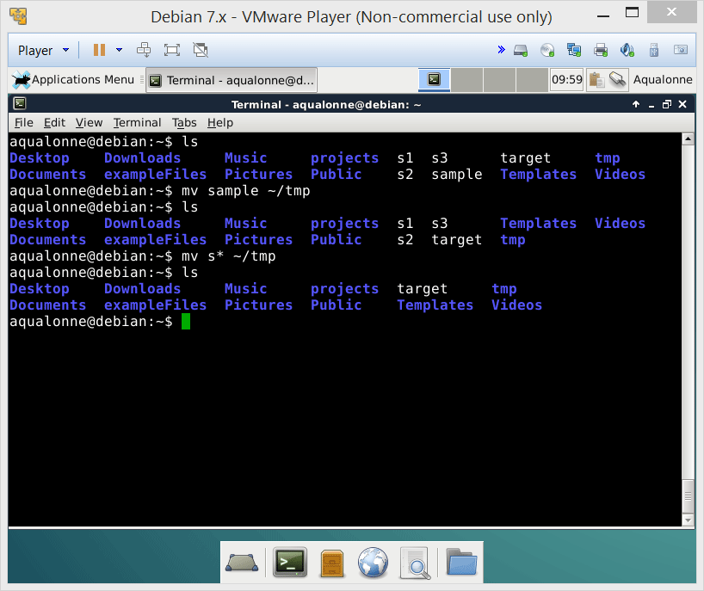
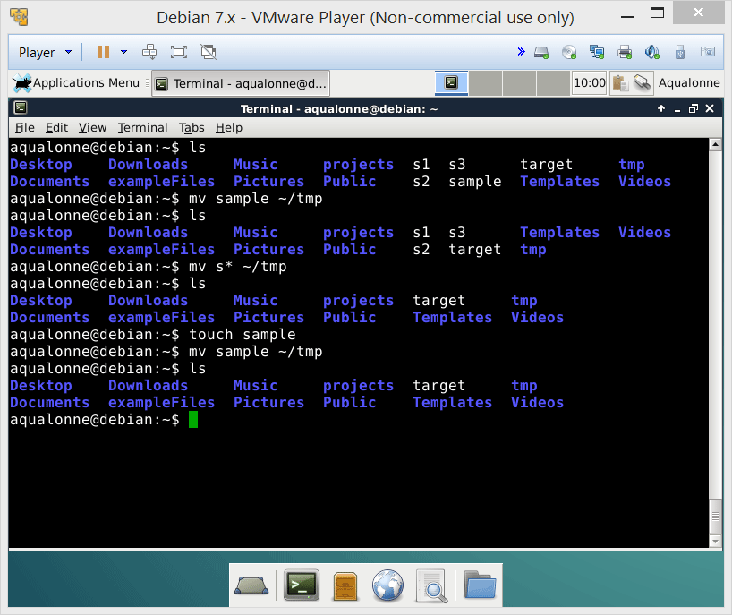
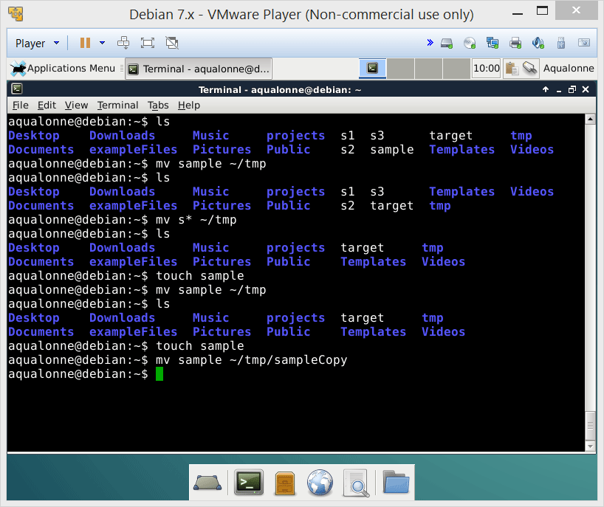
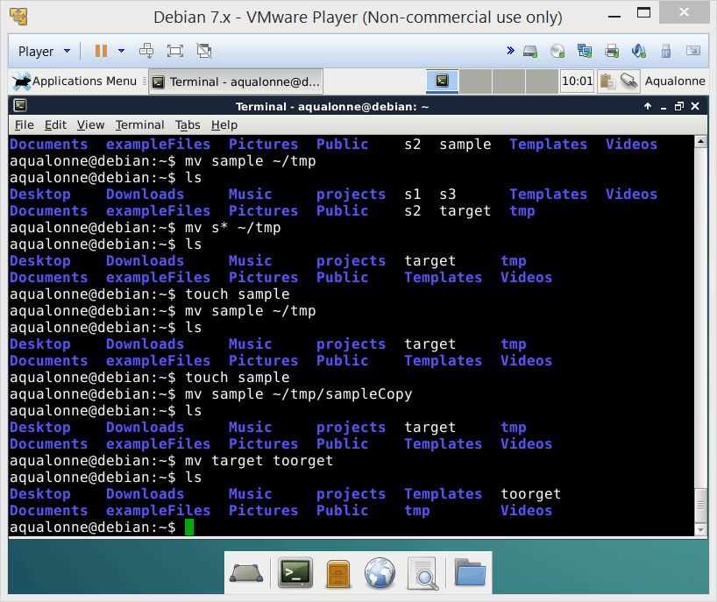

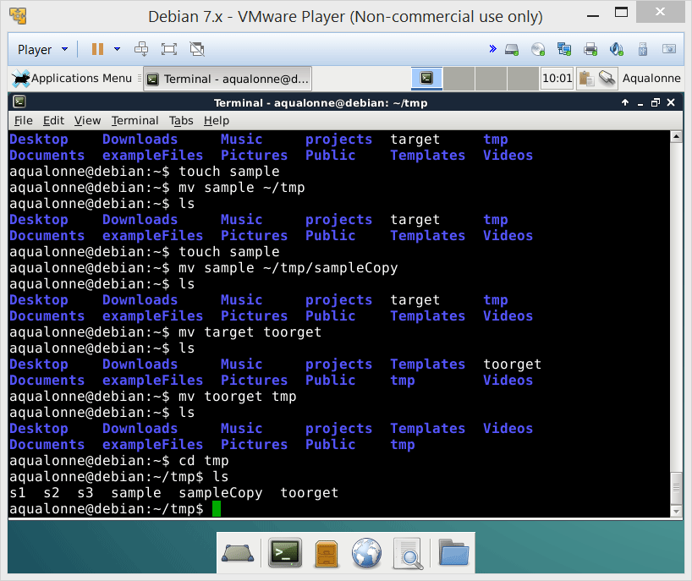
Moving/renaming files or directories
22
Operations for directories and files

Slide 9
Moving/renaming files or directories
mv source source source target
You can move multiple files at the same time.
Either list them all, or use pattern matching.
Can be a folder and/or the new name of the file
If the new name happens to also be the name of a folder, then the file is moved into the folder instead of being renamed.
23
Operations for directories and files

Slide 10



Moving/renaming files or directories
Trashcan
mv / /dev/null
Root of the system
24
Operations for directories and files

Slide 11
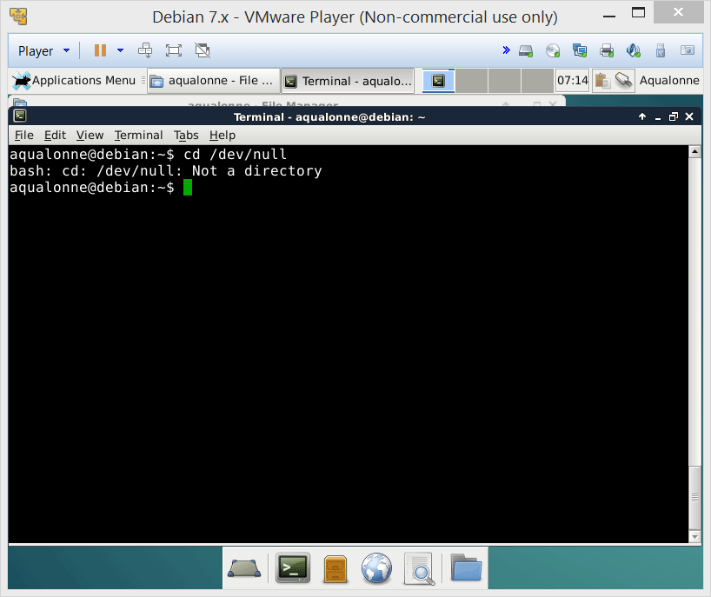
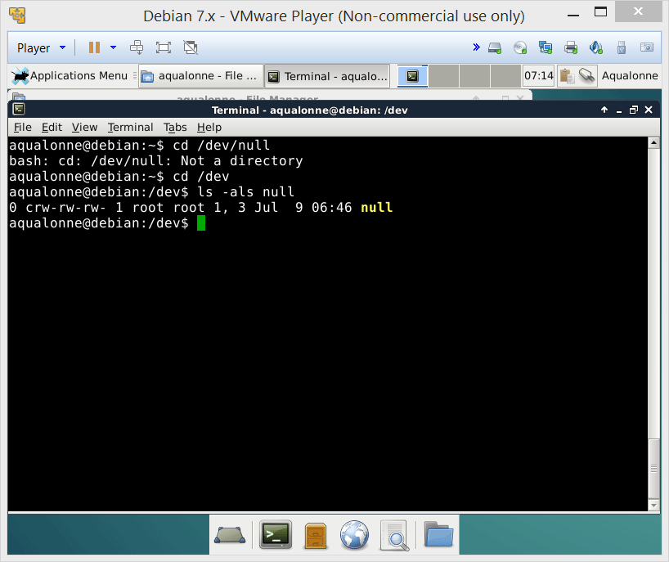
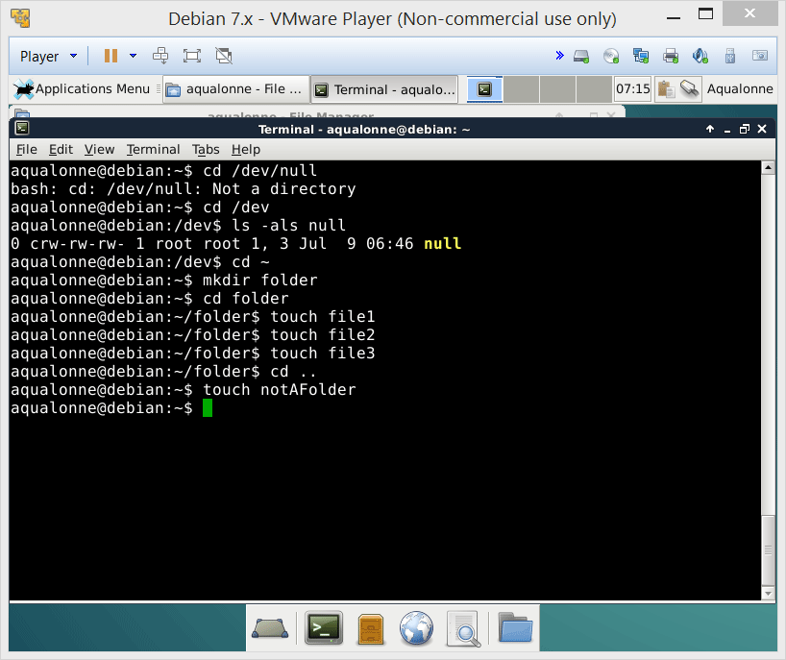
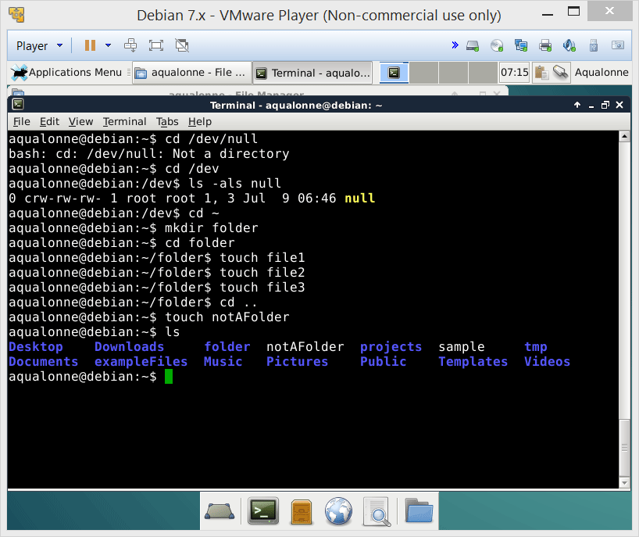
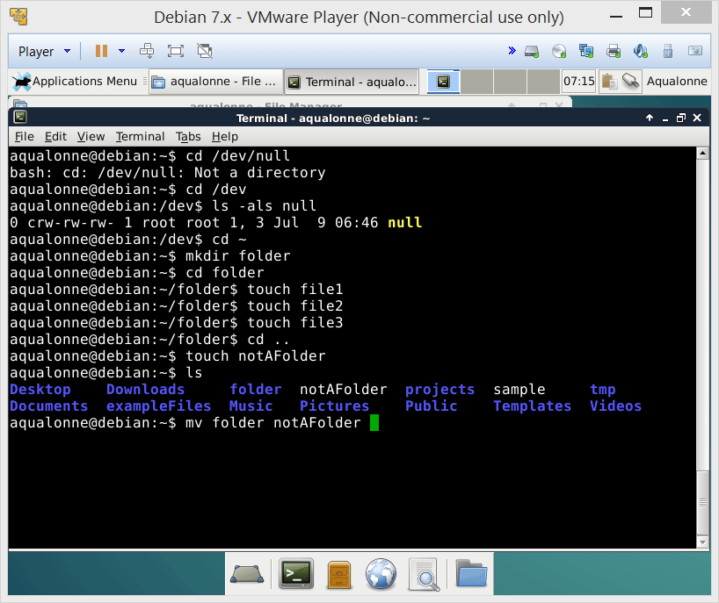
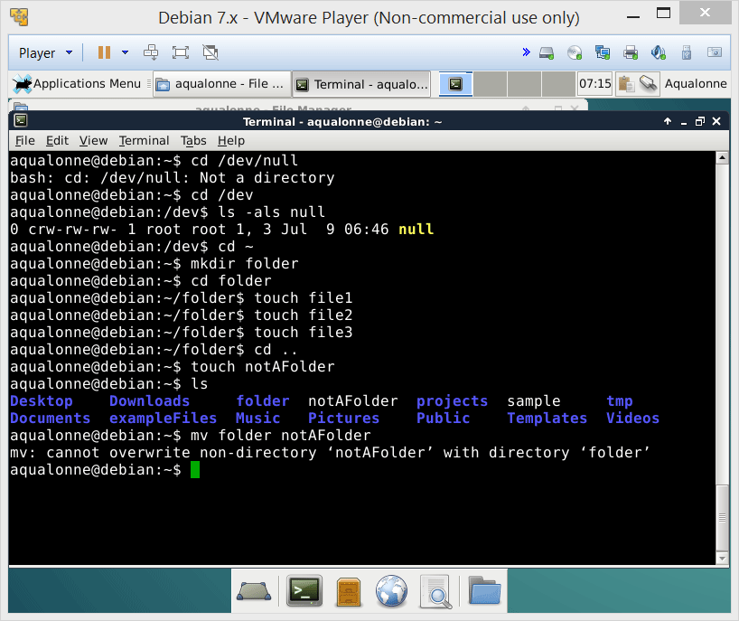
Moving/renaming files or directories
25
Operations for directories and files

Slide 12


Finding files or directories
The find command lets you search using a lot of criteria such as when files were created, how deep in subfolders they might be, how big the files are, etc.
~
tmp
sample
exampleFiles
subtmp1
subtmp2
subtmp3
sample
sampleCopy
s1
s2
s3
sample
subsub
sample
sample
28
Operations for directories and files

Slide 13
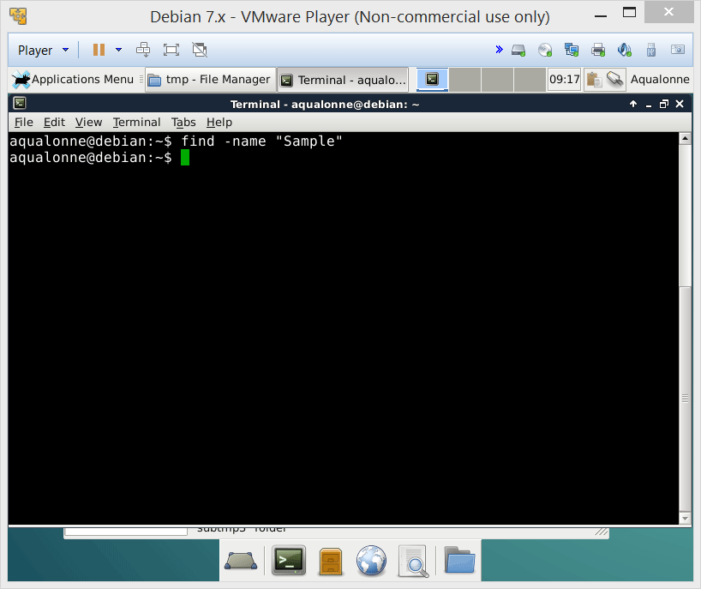
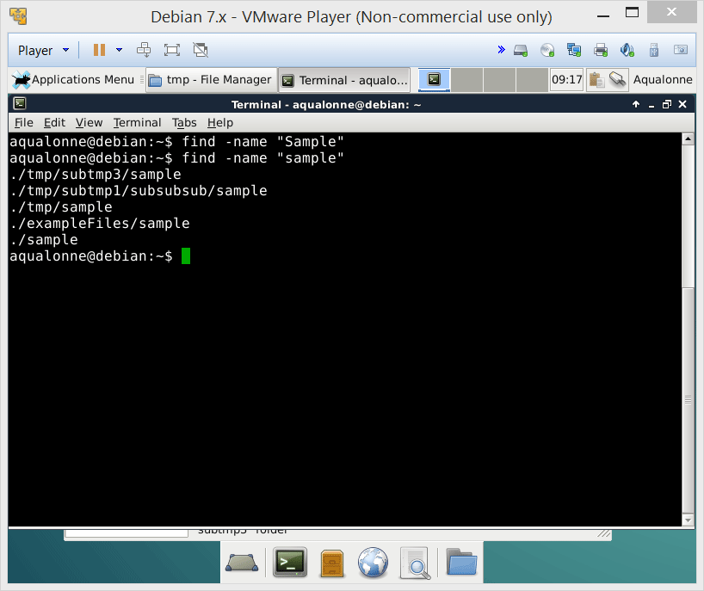
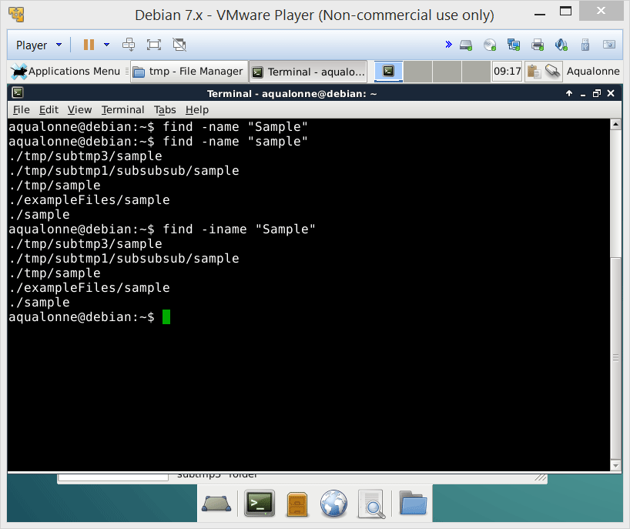
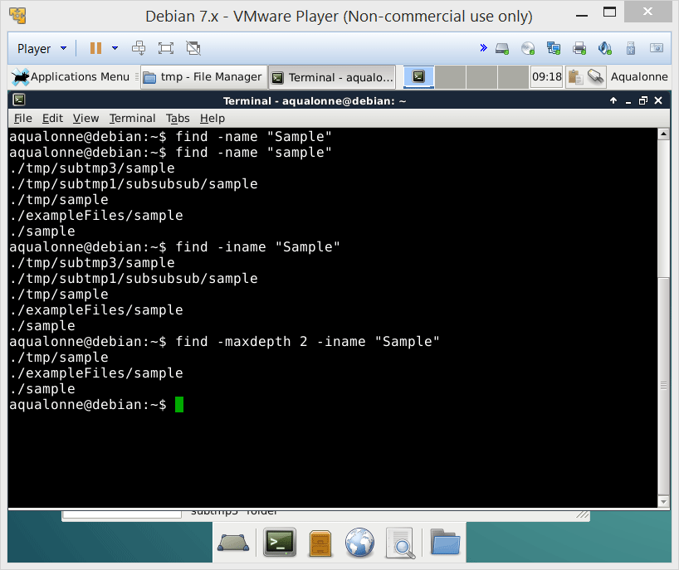
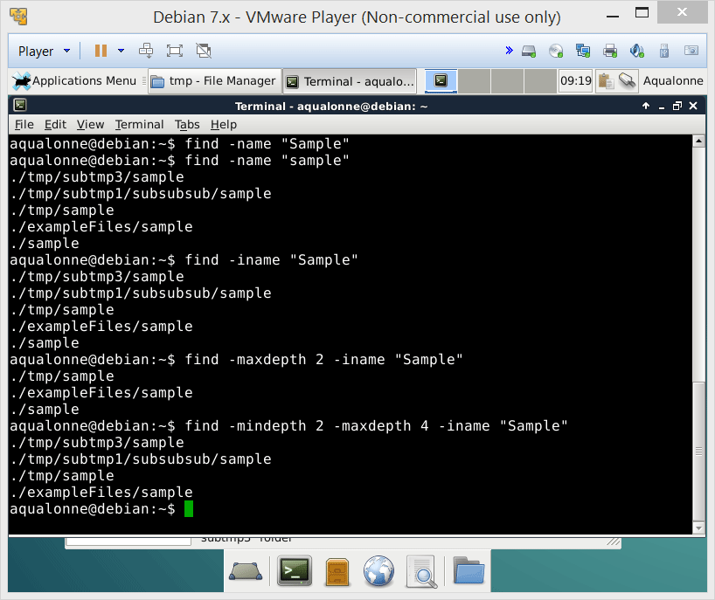
Finding files or directories
29
Operations for directories and files

Slide 14
Finding files or directories
The find command lets you search using a lot of criteria such as when files were created, how deep in subfolders they might be, how big the files are, etc.
~
tmp
sample
exampleFiles
subtmp1
subtmp2
subtmp3
sample
sampleCopy
s1
s2
s3
sample
-mindepth 1 –maxdepth 3
subsub
sample
-mindepth 2 –maxdepth 2
sample
30
Operations for directories and files

Slide 15
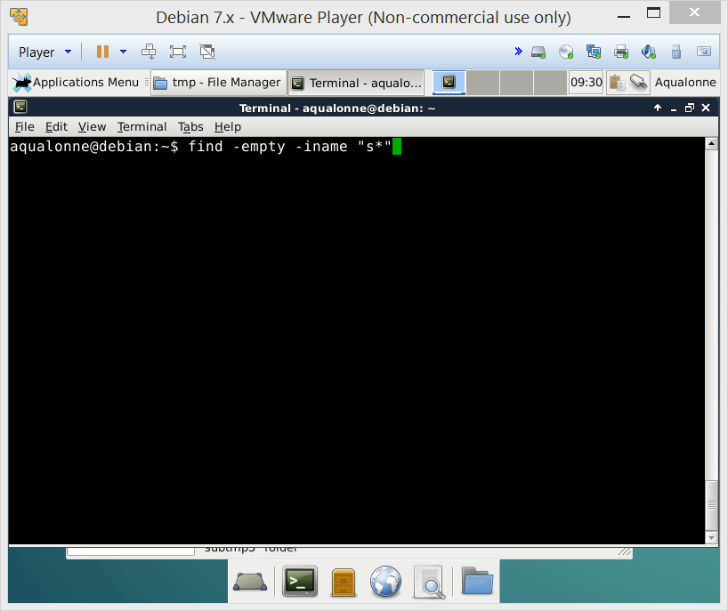
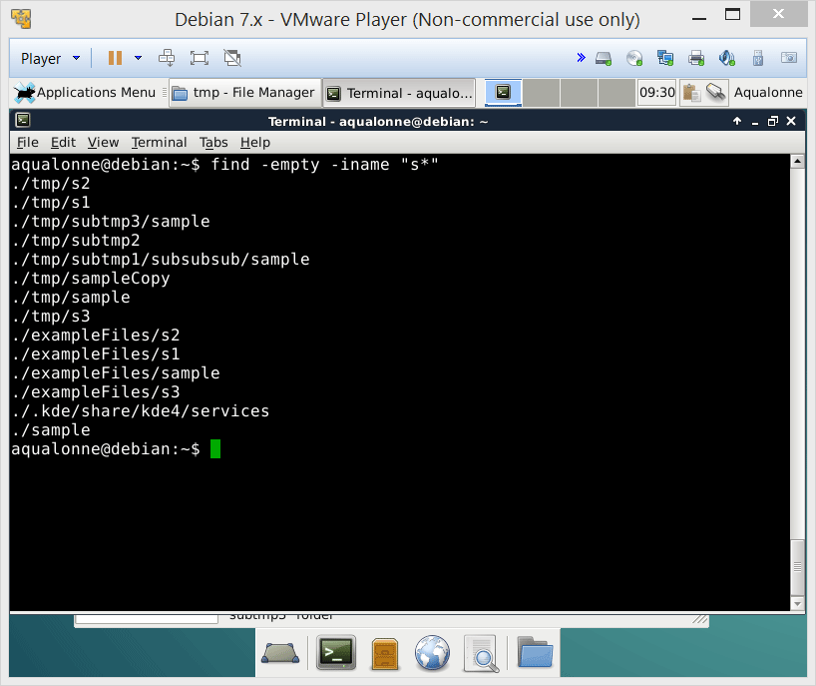
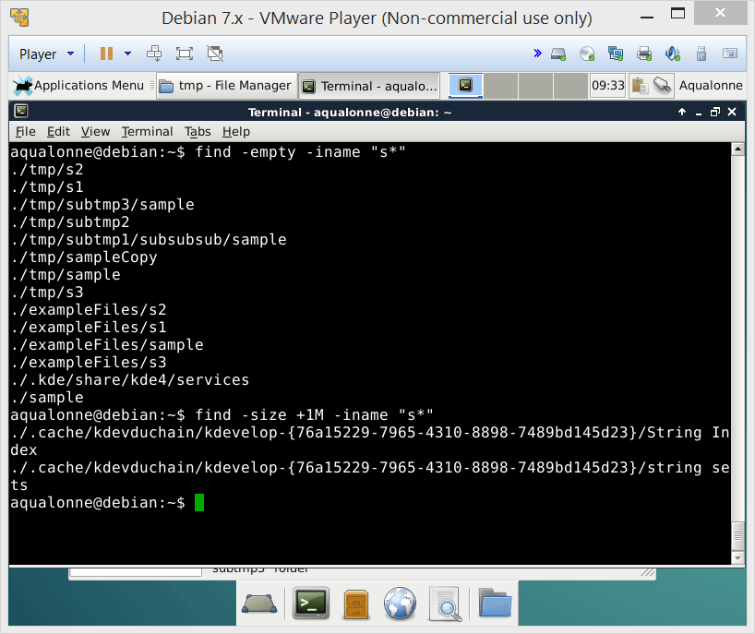
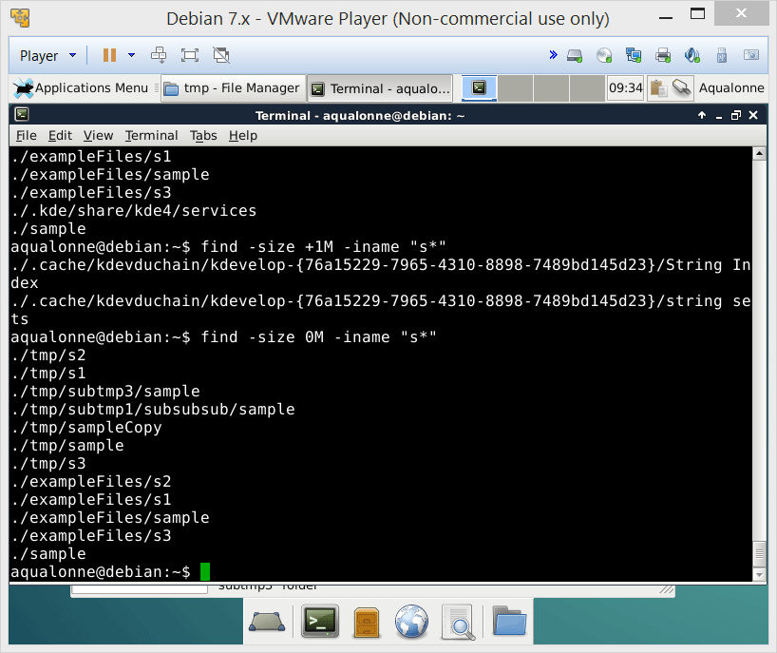
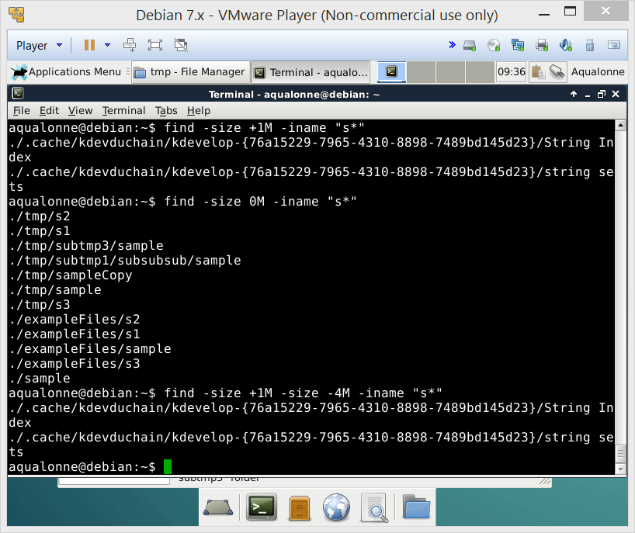
Finding files or directories
31
Operations for directories and files

Slide 16

Finding files or directories
To search for files based on time, you have several ways.
-amin
within minutes
access
within hours
-atime
Time of last
within minutes
-cmin
change
within hours
-ctime
32
Operations for directories and files

Slide 17

Symlinks and hard links
You can create links, just like you create shortcuts in Windows, or pointers in C/C++.
There are 2 types of links. Differences are important!!
Soft link
(or symlink)
Hard link
Points to a path (or place)
Chains the file
If you move the file...
It breaks ☹
It works ☺
If you copy over a file with the same name...
Points to the copy
Points to the old file
If you delete the file...
It breaks ☹
It works ☺
Linking to a different filesystem
Can be done
Cannot be done
34
Operations for directories and files

Slide 18
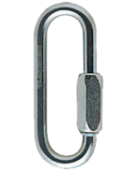



Symlinks and hard links
blah
Hard link
251
251
/blah/file
Symlink
piou
/blah/file
35
Operations for directories and files

Slide 19
Symlinks and hard links
Hard link
251
blah
251
/blah/file
322
You can’t really delete a file that’s got hard link(s). There is no ‘original’ file: all hard links are equally strong hooks on the file. Delete all hard links to really delete the file
file
36
Operations for directories and files

Slide 20
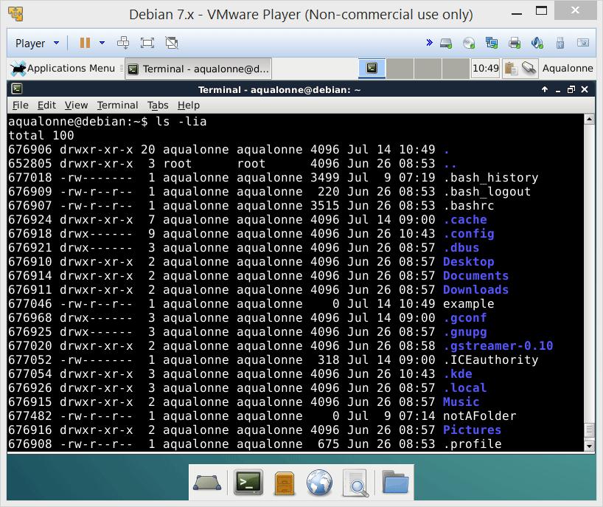
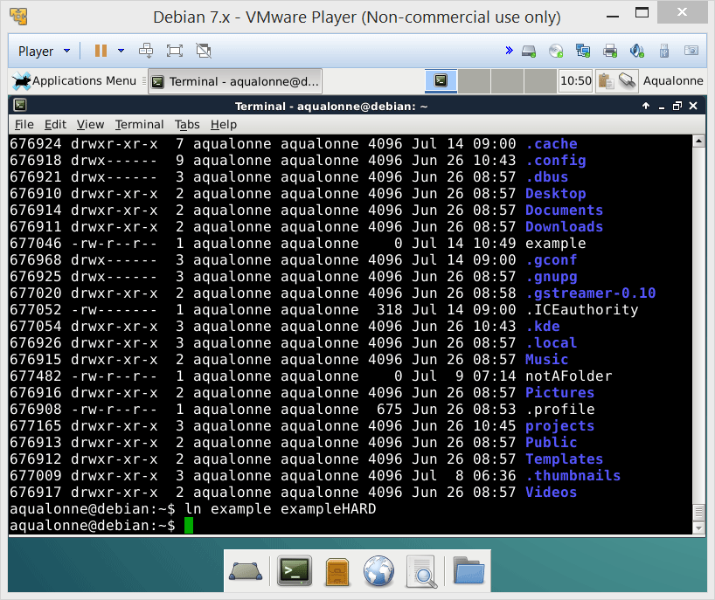
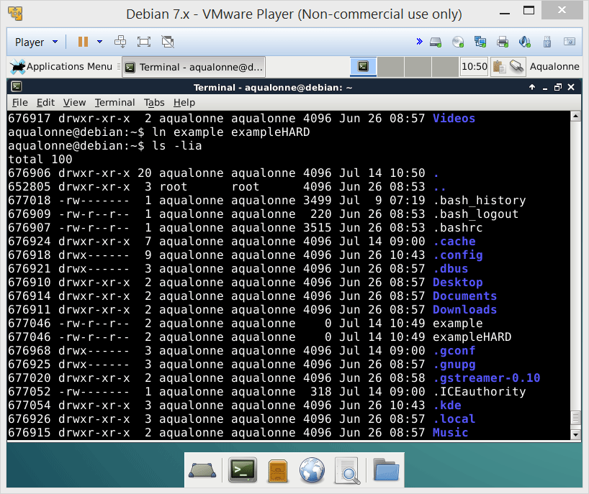
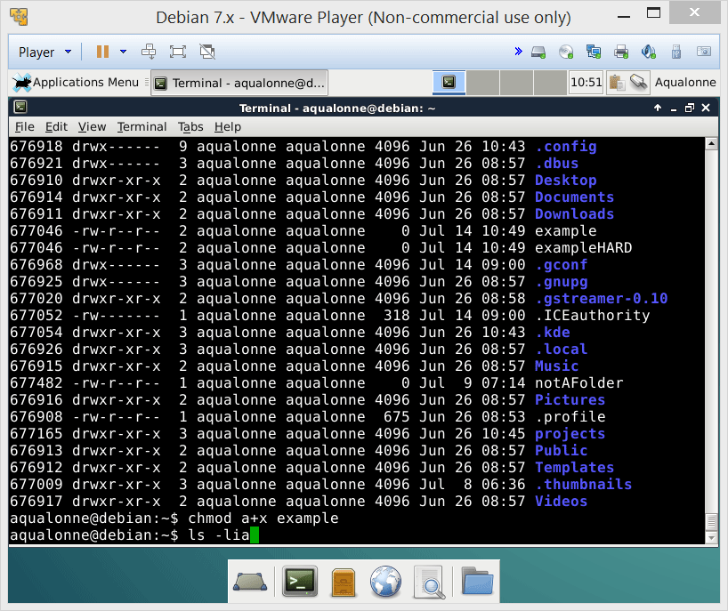
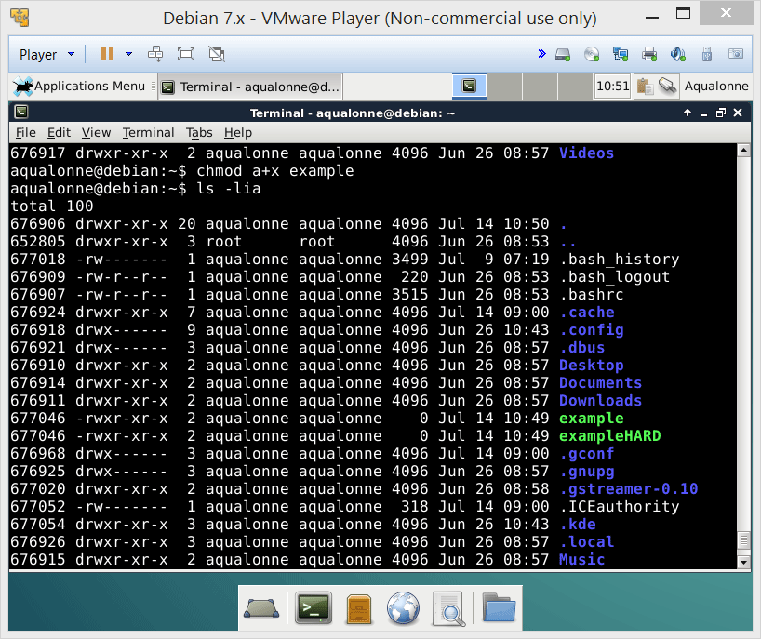

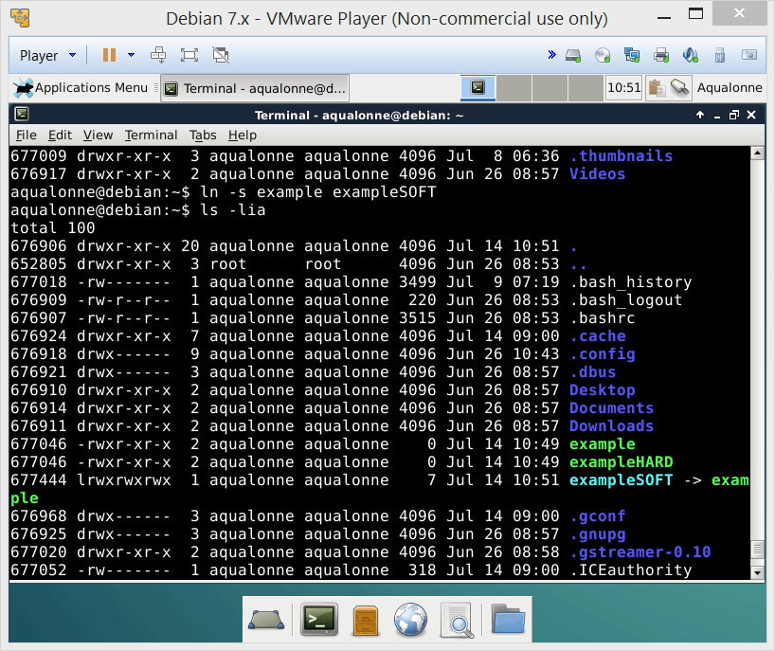
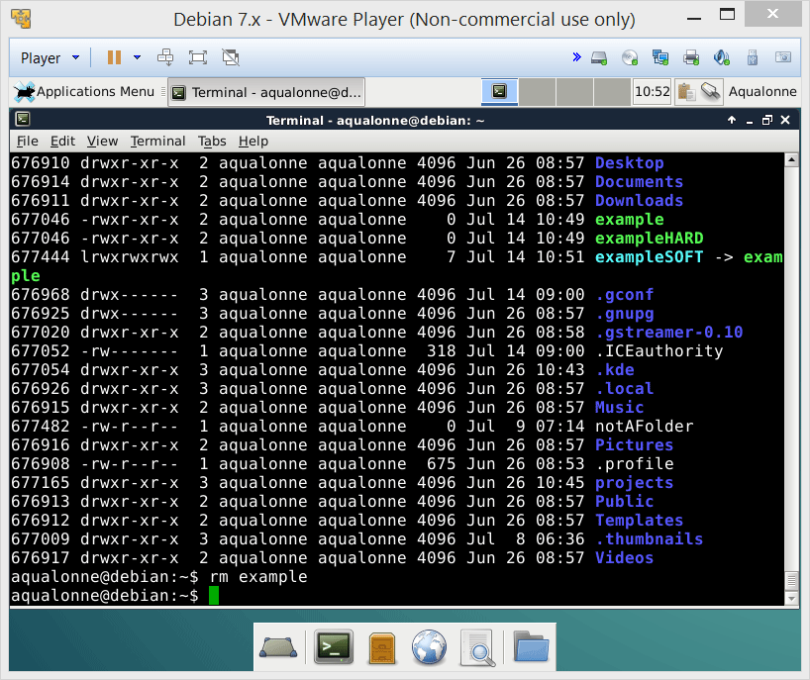
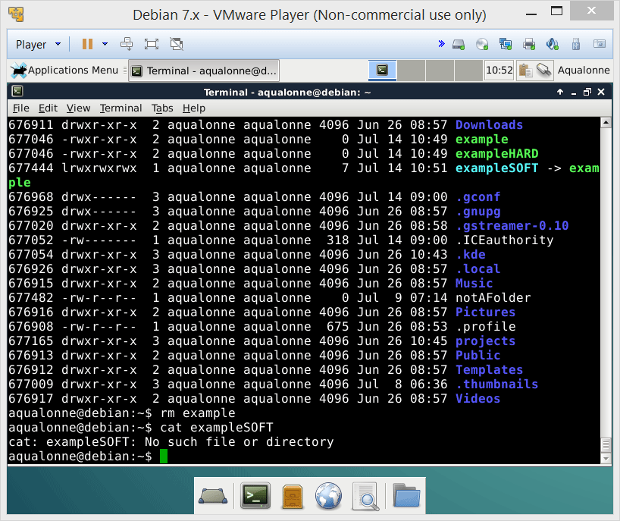
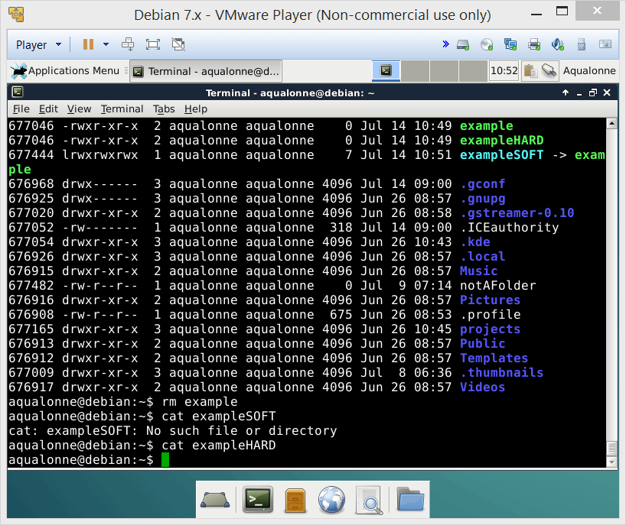
Symlinks and hard links
37
Operations for directories and files

Slide 21

Practice questions & activities
We recommend that you do these, but that’s for your own good, not graded.
Create a hierarchy (using mkdir) of folders (e.g., 3 folders with each having multiple subfolders). Copy files (using cp) to several of these folders, then search for these files (using find).
Create a symlink and several hard links for a file (using ln). Then move (using mv) the file and see how the links behave. Finally, delete the hard links one after the other and see how the count of links changes (using ls -lia).
Search the internet to find out whether symlinks or hard links are faster to access a file. I won’t give you the answer to this one ☺
41
Operations for directories and files

Slide 22
Overview
Files
Display
Create
Edit
Print
Other
lpr
lpq
enscript
cat
touch
more
Compress contents
Count
words
less
Combine contents
pg
Editors (vim,
emacs, nano, …)
Encrypt/
decrypt
Extract contents
head
Unique lines
Redirections
sort
tail
Compare (diff)
3
File display, redirections and pipes

Slide 23
Redirection
To redirect the standard output, you can use either:
Command Syntax | Meaning
command > file | Redirect output from command to file Replaces the file if it already exists.
command >> file | Redirect output of command to file Appends if the file already exists.
To redirect the standard input, use:
Command Syntax | Meaning
command < file | Redirect input from file to command.
9
File display, redirections and pipes

Slide 24
Variables
Variables can come from three ways:
You create them in your code
They are part of the user’s environment (e.g., user id)
They are passed as arguments to the script
Regardless of where they come from,
$name refers to a variable
10
Shell programming: variables and conditionals

Slide 25
Variables
You create them in your code
They are part of the user’s environment (e.g., user id)
They are passed as arguments to the script
variable=value NO SPACE!
$USER All in capital
$0 Script’s name
$# Number of arguments
$1, $2, ..., $9 Arguments
${10}, ... Differs from $1
13
Shell programming: variables and conditionals

Slide 26

Variables
Note that variables are typed. You have:
integers myVar=3
strings myVar=“Hi”
arrays
constants
14
Shell programming: variables and conditionals

Slide 27
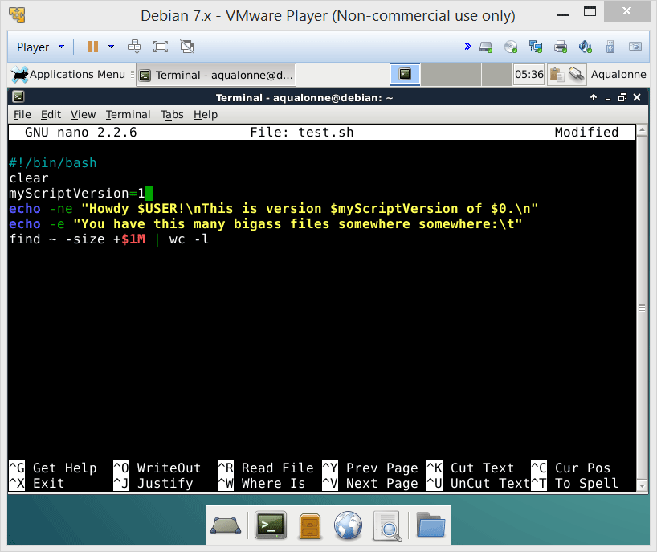
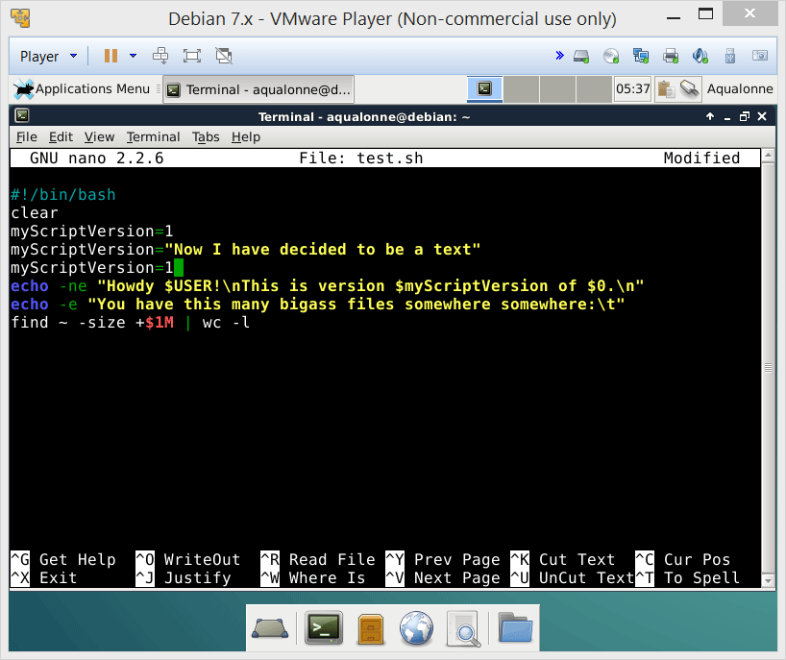
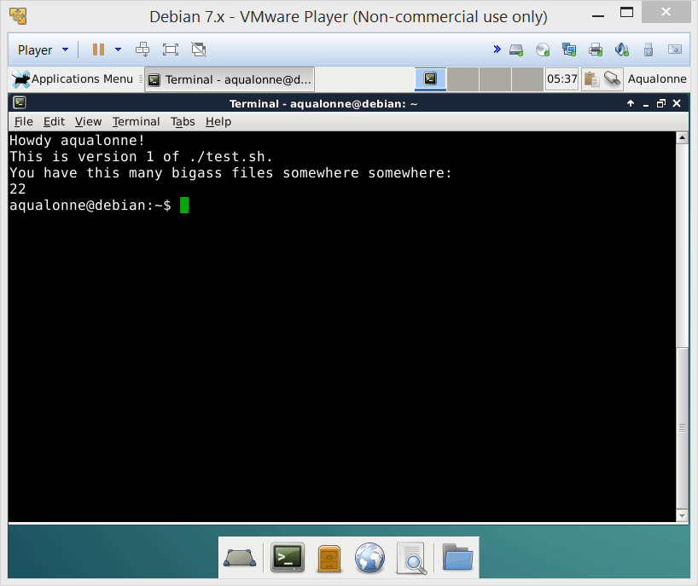
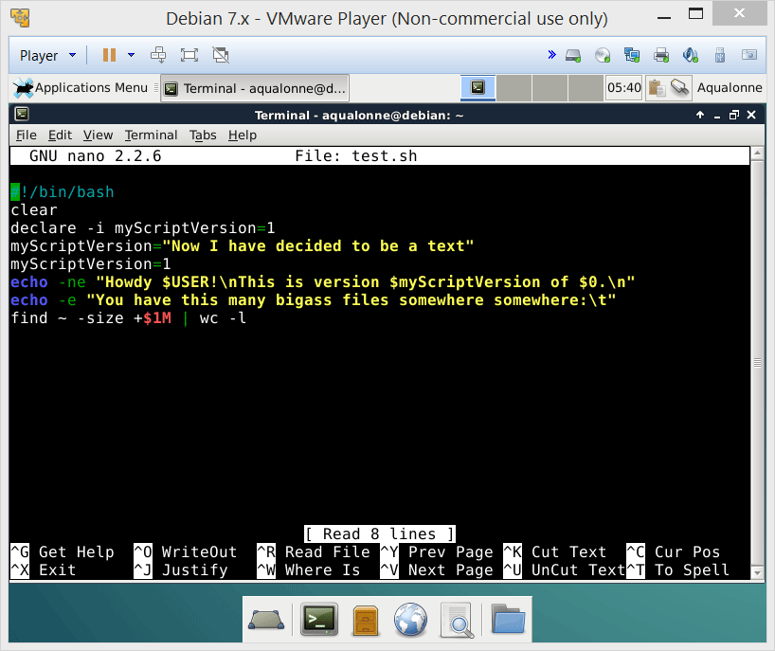
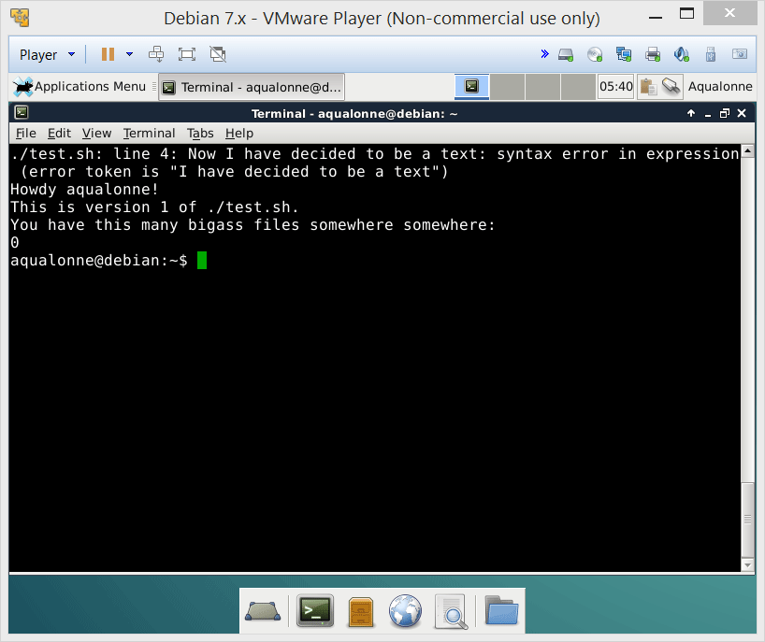
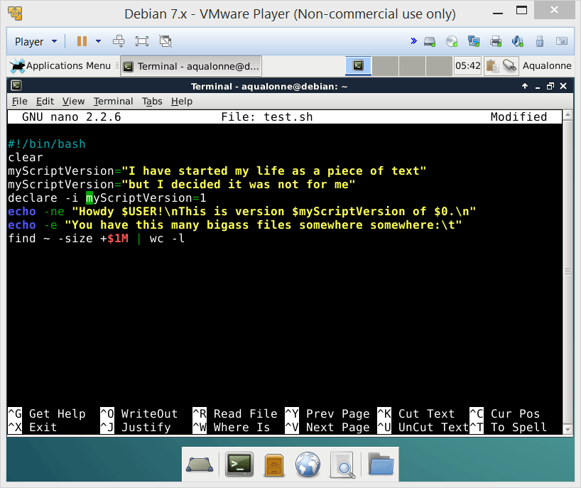
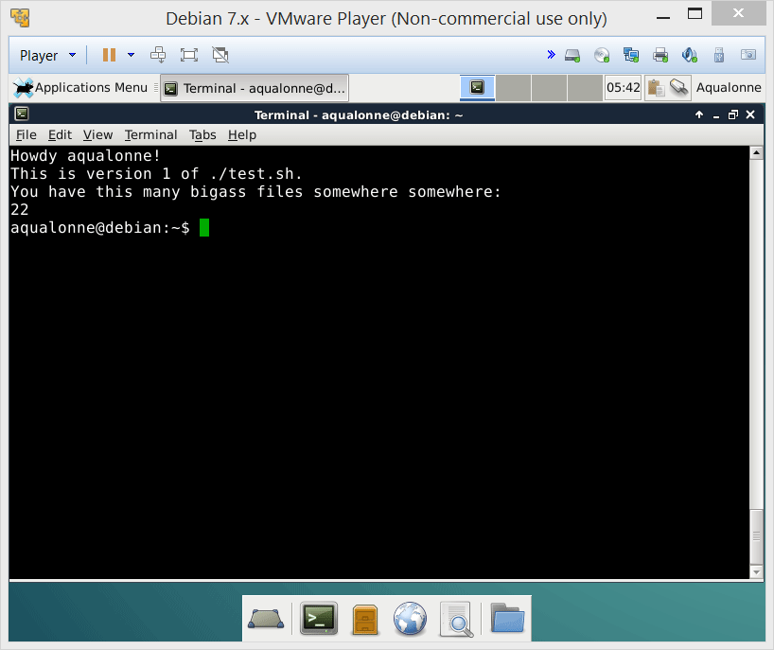
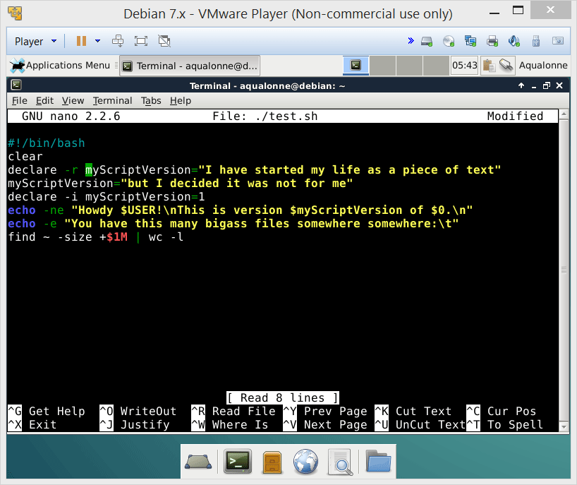

Variables
declare is how you force a variable to behave in one way from there on
-i is to force it as integer
-r is to force it as read only
15
Shell programming: variables and conditionals

Slide 28
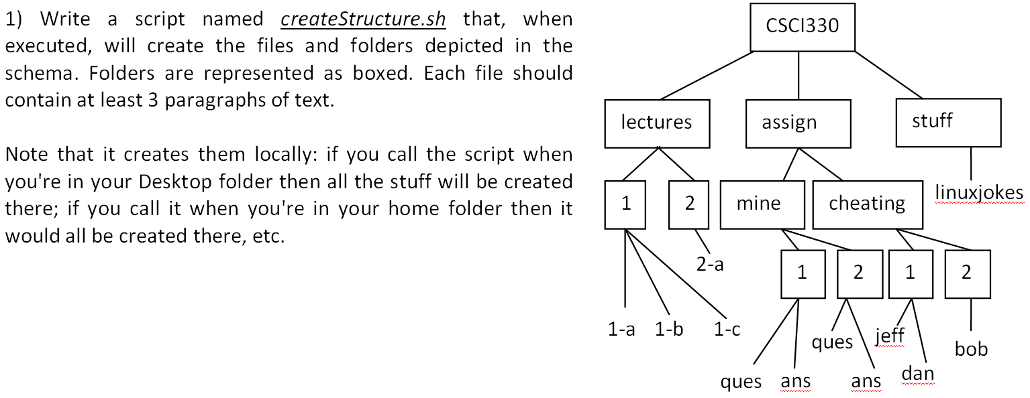
Script practice
18
Shell programming: variables and conditionals

Slide 29

Script practice
#!/bin/bash
mkdir -p CSCI330/lectures/1
cd CSCI330/lectures/1
touch 1-a
touch 1-b
touch 1-c
lorem -p 3 > 1-a
lorem -p 3 > 1-b
lorem -p 3 > 1-c
cd ..
mkdir 2
cd 2
touch 2-a
lorem -p 3 > 2-a
cd ..
cd ..
mkdir -p assign/mine/1
cd assign/mine/1
touch ques
touch ans
lorem -p 3 > ques
lorem -p 3 > ans
cd ..
mkdir 2
cd 2
touch ques
touch ans
lorem -p 3 > ques
lorem -p 3 > ans
cd ..
cd ..
mkdir cheating
cd cheating
mkdir 1
mkdir 2
cd 1
touch jeff
touch dan
lorem -p 3 > jeff
lorem -p 3 > dan
cd ..
cd 2
touch bob
lorem -p 3 > bob
cd ..
cd ..
cd ..
mkdir stuff
cd stuff
touch linuxjokes
lorem -p 3 linuxjokes
20
Shell programming: variables and conditionals

Slide 30

Script practice
I don’t need to go in each
folder. I can just create files and
folders while staying where I am.
Absolute-ish path
22
Shell programming: variables and conditionals

Slide 31
Script practice
#!/bin/bash
#create CSCI330 directory
mkdir ./CSCI330
#create lectures directory and content
mkdir ./CSCI330/lectures
mkdir -p ./CSCI330/lectures/1
mkdir -p ./CSCI330/lectures/2
lorem -p 3 > ./CSCI330/lectures/1/1-a
lorem -p 3 > ./CSCI330/lectures/1/1-b
lorem -p 3 > ./CSCI330/lectures/1/1-c
lorem -p 3 > ./CSCI330/lectures/2/2-a
#creates the assign directory and all of its sub-content
mkdir ./CSCI330/assign
mkdir -p ./CSCI330/assign/mine ./CSCI330/assign/cheating
mkdir -p ./CSCI330/assign/mine/1 ./CSCI330/assign/mine/2
mkdir -p ./CSCI330/assign/cheating/1 ./CSCI330/assign/cheating/2
lorem -p 3 > ./CSCI330/assign/mine/1/ques
lorem -p 3 > ./CSCI330/assign/mine/1/ans
lorem -p 3 > ./CSCI330/assign/mine/2/ques
lorem -p 3 > ./CSCI330/assign/mine/2/ans
lorem -p 3 > ./CSCI330/assign/cheating/1/jeff
lorem -p 3 > ./CSCI330/assign/cheating/1/dan
lorem -p 3 > ./CSCI330/assign/cheating/2/bob
#creates stuff directory and content
mkdir ./CSCI330/stuff
lorem -p 3 > ./CSCI330/stuff/linuxjokes
22 lines
23
Shell programming: variables and conditionals

Slide 32
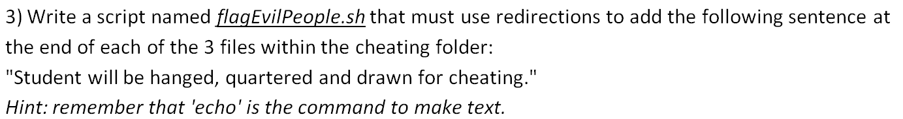
Script practice
#!/bin/bash
echo $'\n'"Student will be hanged, quartered and drawn for cheating." >> ./CSCI330/assign/cheating/1/jeff
echo $'\n'"Student will be hanged, quartered and drawn for cheating." >> ./CSCI330/assign/cheating/1/dan
echo $'\n'"Student will be hanged, quartered and drawn for cheating." >> ./CSCI330/assign/cheating/2/bob
25
Shell programming: variables and conditionals

Slide 33
Conditionals
Somewhat compact style:
if [ test ] ; then consequence ; fi
or with a bit of formatting...
if [ test ]
then
consequence
fi
Something that’s true or false
Anything
They do exactly the same. Use whichever you want.
27
Shell programming: variables and conditionals

Slide 34
Conditionals
Tests for numbers or strings
Meaning | Numeric | String
Greater than | -gt
Greater than or equal | -ge
Less than | -lt
Less than or equal | -le
Equal | -eq | =
Not equal | -ne | !=
String length is zero |  | -z str
String length is non-zero |  | -n str
file1 is newer than file2 |  | file1 -nt file2
file1 is older than file2 |  | file1 -ot file2
28
Shell programming: variables and conditionals

Slide 35
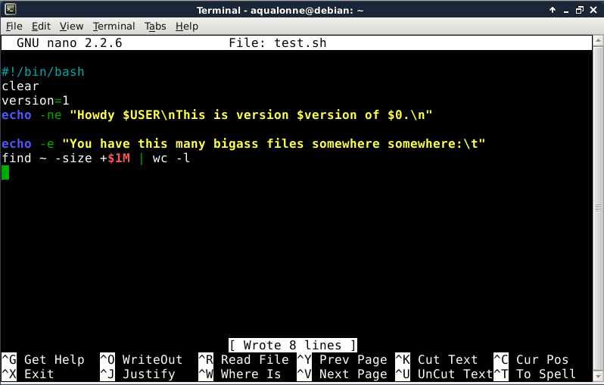
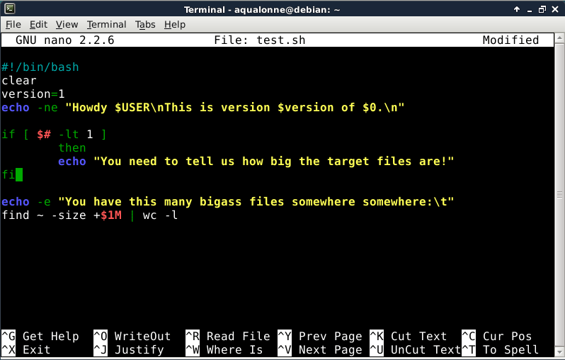





Conditionals
Here is the program as it stands currently. If we want to tell the user that we need at least one argument, what should we do?
Space around [ ]
And what if I don’t put the space...
29
Shell programming: variables and conditionals

Slide 36








Conditionals
What do you think it’ll do if we don’t give it an argument now?
if [ test ]
then
consequence
elif [ test ]
then
consequence
elif [ test ]
then
consequence
else
consequence
fi
Whiny...
If we don’t get 1 arg, notify the user and don’t try.
I we get 1 arg, do it.
...is there any case we’re forgetting here?
But tries anyway and starts throwing out errors
30
Shell programming: variables and conditionals

Slide 37
Conditionals
if [ test ]
then
consequence
else
if [ test ]
then
consequence
else
if [ test ]
then
consequence
else
consequence
fi
fi
fi
if [ test ]
then
consequence
else
if [ test ]
then
consequence
elif [ test ]
then
consequence
else
consequence
fi
fi
if [ test ]
then
consequence
elif [ test ]
then
consequence
elif [ test ]
then
consequence
else
consequence
fi
You can also have nested conditionals. But do it when necessary, not just to waste space ☺
31
Shell programming: variables and conditionals

Slide 38


Conditionals
32
Shell programming: variables and conditionals

Slide 39
Script practice
1) Write a script that takes as argument a folder name. If no argument is provided, tell the user one is needed. If two arguments are provided, tell the user we need only one. If one argument is provided, then make a folder with that name.
33
Shell programming: variables and conditionals

